Slide 1
Rockbuster Stealth Data Analysis

Slide 2
RocKbuster
Rockbuster Stealth LLC is a movie rental company that used to have stores around the world. Facing stiff competition from streaming services such as Netflix and Amazon Prime, the Rockbuster Stealth management team is planning to use its existing movie licenses to launch an online video rental service in order to stay competitive.

Slide 3
Key Questions and Objectives
Which movies contributed the most/least to revenue gain?
What was the average rental duration for all videos?
Which countries are Rockbuster customers based in?
Where are customers with a high liftetime value based?
Do sales figures vary between geographic regions?

Slide 4
Film data overview
Rental Duration | Days
Minimum | 3
Maximum | 7
Average | 4.985
Rental Rate | Dollars
Minimum | 0.99
Maximum | 4.99
Average | 2.89
Movie length | Minutes
Minimum | 46
Maximum | 185
Average | 115.272
Replacement cost | Dollars
Minimum | 9.99
Maximum | 29.99
Average | 19.984

Slide 5
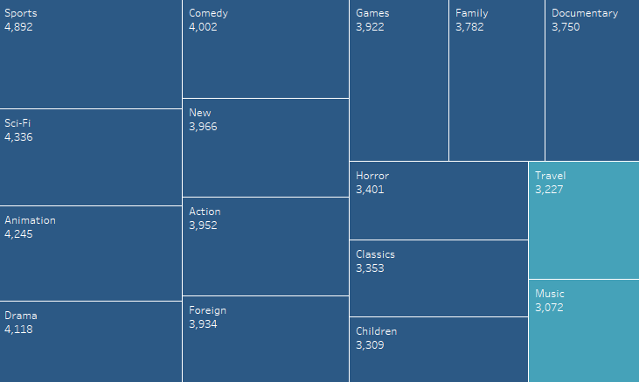

Revenue By genre
Most revenue gain:
Sports
Sci-Fi
Animation
Least revenue gain:
Thriller
Music
Travel

Slide 6
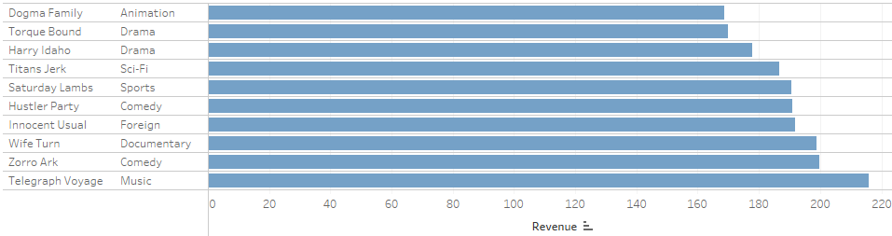
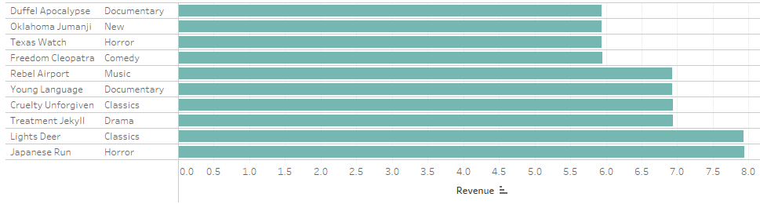
Revenue By Movie
Top 10 movies
Bottom 10 movies

Slide 7
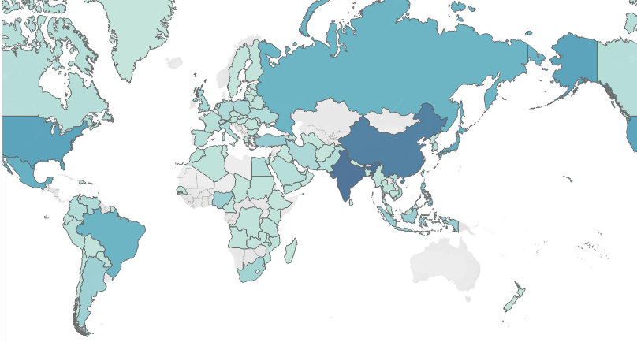

Countries Rockbuster customers are based in
Rockbuster have customers all over the world.
Most customers in:
India (60)
China (53)
USA (36)

Slide 8
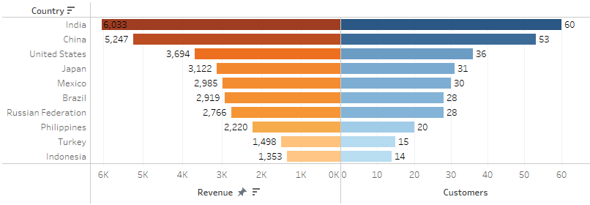
TOP 10 countries

Slide 9
Top 10 cities in top 10 countries
RANK | CITY | COUNTRY | REVENUE
1 | Cape Coral | United States | 208.58
2 | Santa Brbara dOeste | Brazil | 194.61
3 | Memphis | United States | 167.67
4 | Valpari | India | 162.67
5 | Aurora | United States | 159.58
6 | Halisahar | India | 154.70
7 | Bijapur | India | 154.66
8 | Usolje-Sibirskoje | Russian Federation | 152.69
9 | Probolingoo | Indonesia | 152.68
10 | Zhoushan | China | 151.69

Slide 10
Top 5 customers in top 10 countries
RANK | FIRST NAME | LAST NAME | CITY | COUNTRY | TOTAL PAID
1 | Sara | Perry | Atlixco | Mexico | 128.7
2 | Gabriel | Harder | Sivas | Turkey | 108.75
3 | Sergio | Stanfield | Celaya | Mexico | 102.76
4 | Clinton | Buford | Aurora | United States | 98.76
5 | Adam | Gooch | Adoni | India | 97.8

Slide 11
Conclusions & recommendations
Sports, Sci-Fi and Animation contributed to most revenue gain
The average rental duration is 4.985 days
Customers are based all over the world
India, China and the United States have the highest customer numbers and highest revenue
Sales figure vary between regions - Revenue in India (number 1 country) = $6,033, - Revenue in Indonesia (number 10 country) = $1,353
Top 5 customers are based in Mexico, Turkey, United States and India

Slide 12
Conclusions & recommendations
Recommend to increase number of movies in low performing genres to boost sales, but still focus on high revenue countries and genres
Highest paying customers could be rewarded for their loyalty
Also reward customers who are fast at returning the rented movies, as this is good for the inventory
Rewards could be given in terms of a point system, where a certain amount of points will give discounts and free rentals.

